Slide 1

Lucidity Assignment
By: Praveen Doifode

Slide 2
Index
Problem Statement
Introduction
Challenges
High Level Architecture
AWS Focused Solution
Security
Scalability
Configuration
Assignment Question & Answer

Slide 3
Problem Statement
Enterprise growth and Infra fragmentation increases concerns about potential disk space issue across multi cloud and multi environments.
No unified operational dashboard across cloud providers leads to silent disk exhaustion and unplanned downtime.
Want to leverage existing Ansible along with cloud native tools.
Solution should be reliable and scalable for future growth
Ease of Access & Management with Continuous disk space & metric monitoring

Slide 4
Introduction
As cloud Infrastructure spread across multiple AWS accounts, maintaining storage visibility becomes complex and difficult that could lead to unplanned downtime caused by disk space.
This assignment is designed to deliver a centralized monitoring solution focused specially on the AWS cloud, using AWS cloud native services and configuration
Using Ansible playbook, will help to discover and install the CloudWatch agents on available EC2 instances

Slide 5
challenges
No Centralized dashboard to monitor the multi account on single pane of glass
High potential risk for unplanned downtime due to disk space exhaustion
High human intervention required to expand storage
High Effort required to manage the storage

Slide 6
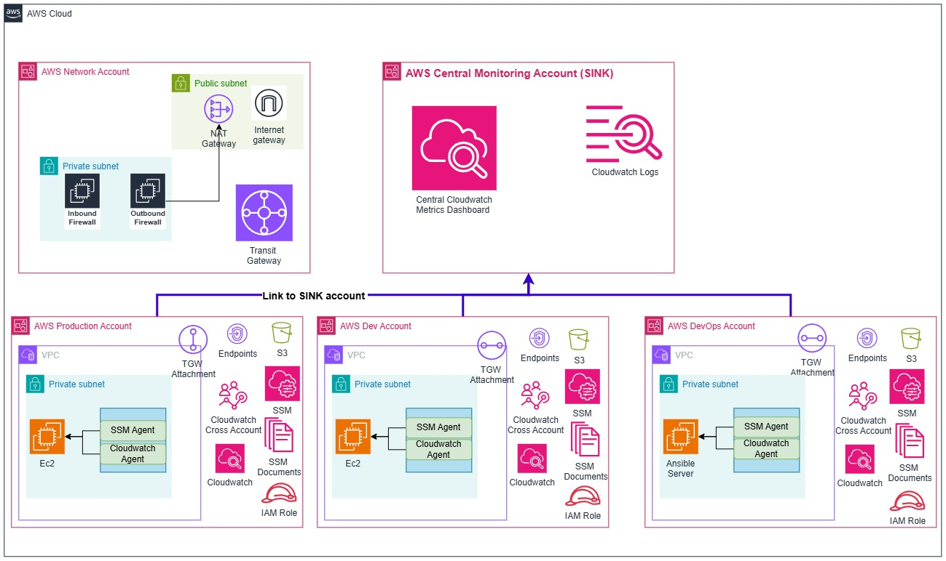
High Level Architecture

Slide 7
AWS Focused solution
AWS OAM:
  AWS provide a solution called Observability Access Manager (OAM) for centralized dashboarding
  Creating a centralized monitoring account (SINK), server can share their Logs, Metrics into this account.
  AWS link between source account and SINK account that is created in a monitoring account
  When a link is created, we can optionally specify filters that specify which metric namespaces and which log groups are shared from the source account to the monitoring account.

Slide 8
AWS Focused solution
Monitoring & Alerting:
  AWS CloudWatch agent will be deployed on each server to monitor the OS-level disk utilization
  Agent will stream the disk details to local AWS account’s CloudWatch service
  AWS CloudWatch service in local/source account then stream the collected metrics to SINK Account (Centralized Monitoring account)
  Create centralized dashboard for disk utilization in monitoring account
  Every Account will have its own alarm configured with defined threshold
  Configure the alarm threshold to 85% or defined by organization
  Configure disk utilization alarms to send user notifications and trigger Amazon EventBridge for auto-remeditation

Slide 9
AWS Focused solution
Ansible:
  Ansible dynamic discovery plugin will help to automatically query the multiple AWS accounts to discover the EC2 instance
  AWS cross account IAM role will be used to scan the multiple account
  Ansible playbook to create and configure the SINK and link to source account.
  Make sure the SSM service is installed on all servers allowing Ansible to connect via AWS SSM instead of managing SSH keys (Port 22)
  Ansible Playbook helps to call AWS SSM cloud native service to install and configure the CloudWatch agent on EC2 instance
  Ansible playbook to create the SSM document for disk expansion

Slide 10
AWS Focused solution
  Auto Remediation
  Create SSM document in every account for auto-remediation
  Configure Amazon EventBridge in every account to invoke AWS SSM Automation
  Execute SSM Automation document to increase EBS disk capacity by 20% (Linux OS)

Slide 11
Security
IAM:
  AWS IAM roles are used by the Ansible control server to communicate securely with AWS APIs
  Provides dynamically generated short-lived STS key
  Eliminates hardcoded access key or secret key within Ansible configuration
  Enforce encrypted communication using HTTPS method
  Applies granular, least-privilege permissions to each IAM role to minimize the blast radius.

Slide 12
Security
  AWS Endpoints:
    Provide private AWS API access directly within the VPC without routing traffic over the public internet.
    Enable Ansible to execute AWS API calls for AWS SSM, monitoring services, and infrastructure provisioning securely.
    Route all API traffic exclusively over the private AWS network backbone

Slide 13
ScalAbility
Dynamic Discovery: Ansible will deploy the CloudWatch agent for every new discovered EC2 instance
Elimination of SSH, SSM works with AWS backbone API to communicate with EC2 instance that removes the bottleneck managing SSH lifecycle.
Automated On-boarding of EC2 instance with the standard IAM profile, SSM commands for agent installation and alarm configuration with triggers to auto-remediation
Decentralized auto-remediation protect from single point of failure means even if some issue in an account will not impact the other because every account has its own alarm and remediation
Parallel execution of alarm and auto-remediation and it can scale upto AWS provided limit if any.

Slide 14
Configuration
Please refer to Cloud Formation Template code to create cross account IAM role for account discovery: Link
Please refer to the Ansible playbook for OAM SINK creation: Link
Please refer to the Ansible playbook for OAM SINK json policy: Link
Please refer to the Ansible playbook for OAM link creation for source account: Link
Please refer to the Ansible playbook for AWS SSM Document for Agent installation: Link
Please refer to the Ansible playbook for AWS Parameter to store the agent disk configuration: Link
Please refer to the Ansible playbook for AWS SSM document for disk expansion (Linux): Link
Please refer to the Ansible playbook for On-boarding a EC2 instance: Link

Slide 15
Assignment Question & Answers
Ease of Access & Management
  How will you securely manage VMs across multiple accounts/projects?
  How will Ansible connect or collect data from the VMs reliably and securely?
  Ans: Slide number 9 covers the statement: click
  Highlights:
    Ansible Dynamic Discovery plugin used to Manage across multiple Accounts
    AWS Cross account IAM role will be used to scan across multiple account securely using AWS Backbone

Slide 16
Assignment Question & Answers
Data Collection & Aggregation
  How will you gather disk usage data from all VMs?
  How will you centralize and present this data for easy monitoring?
  Ans: Slide number 9 covers the statement: click
  Highlights:
    AWS CloudWatch agent is deployed across all EC2 instance (via Ansible) to gather OS-level disk utilization and stream them to local AWS account’s CloudWatch service.
    AWS securely streams the disk metrics from each source account to central monitoring account.

Slide 17
Assignment Question & Answers
Scalability
  How will your solution handle growth as more accounts or VMs are added over time?
  Ans: Slide number 13 covers the statement: click
  Highlights:
  Ansible Dynamic Discovery plugin will discover the new server across AWS account and execute the automation to deploy the CloudWatch agent for every new discovered EC2 instance

Slide 18
Thank You

